Slide 1

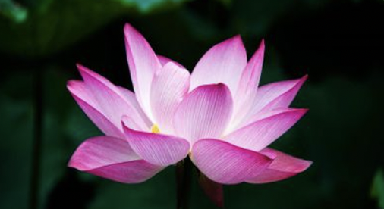
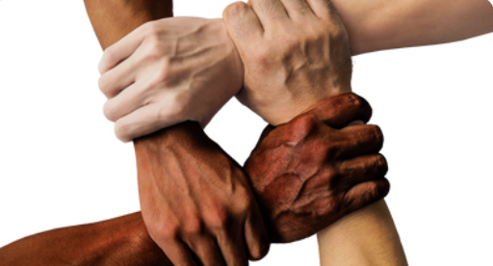









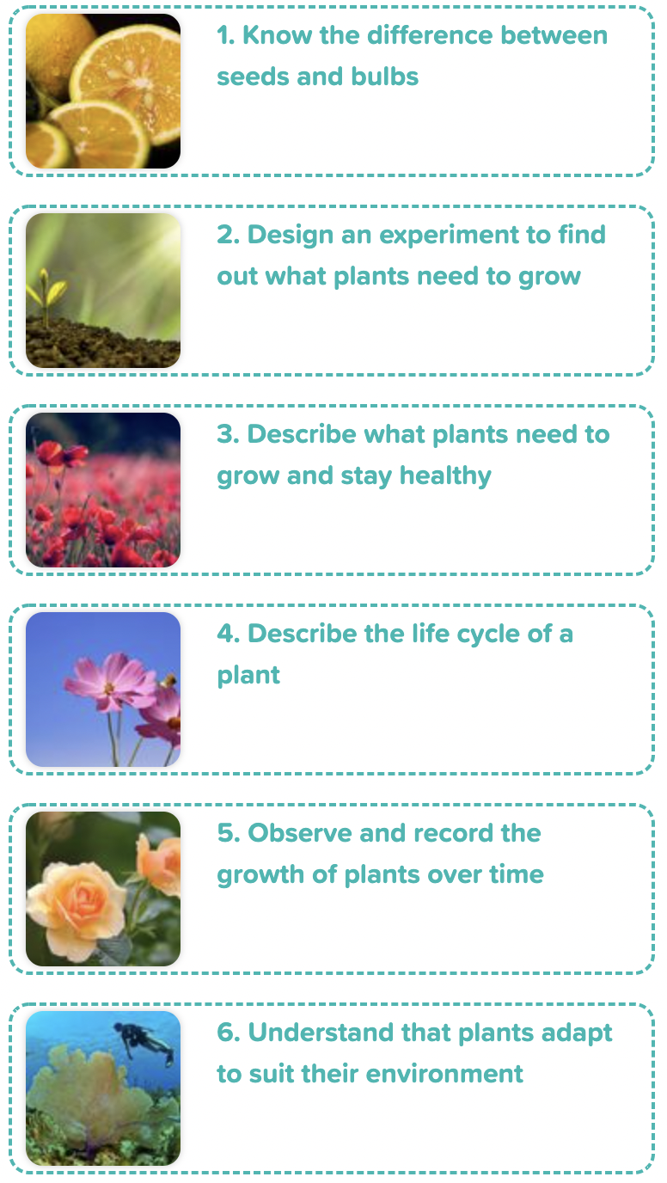
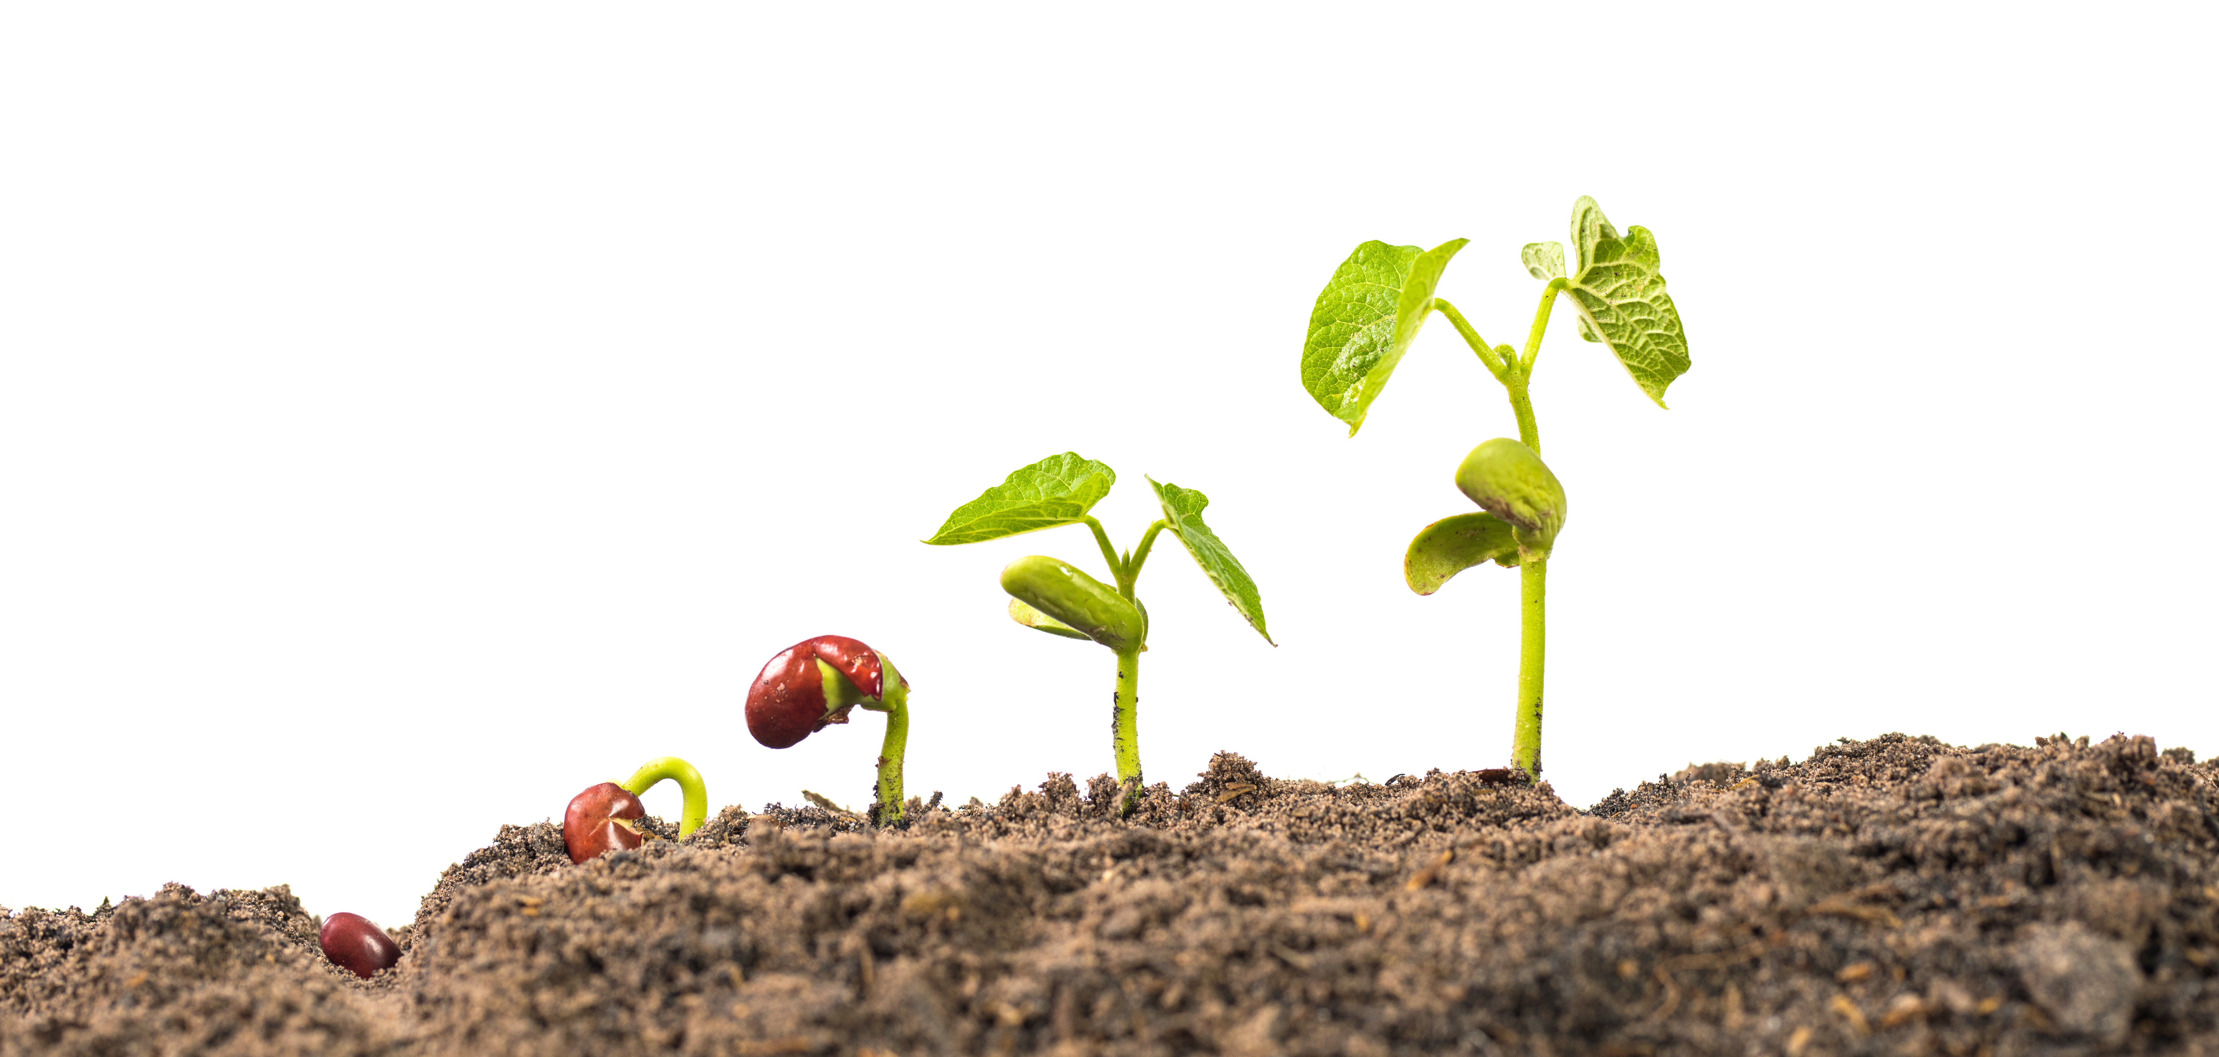
Careers connected to plants:
horticultural management, plant biologist, plant pathologist
Knowledge Organiser: Plants
Careers connected to the human body:
doctor, nurse, massage therapist, personal trainer, theatre technician
Life Cycle of a Plant
What Plants Need to Grow
Lesson Sequence
A plant germinates when it starts to grow. Inside a seed/bulb is the baby plant. Seeds are covered with a seed coat.
Seeds need the right conditions to grow. Seeds need water, air and the right temperature to grow.
Plants need water to survive. Plants get water through their roots.
Plants need the right temperature to grow.
Plants need sunlight to help them grow and make their own food.
Plants need room to grow. Plants need time to grow. It can take days, months or even years for them to grow.
1. Know the differences between seeds and bulbs
2. Design an experiment to find out what plants need to grow
3. Describe what plants need to grow and stay healthy
Life Cycle of a Plant
Plants begin life as seeds or bulbs. They need soil, air and water to grow. Plants grow into young plants called seedlings. Plants grow flowers and fruits. These produce seeds. When the plant is pollinated, the seeds find their soil. The process starts again!
4. Describe the life cycle of a plant
5. Observe and record the growth of plants over time
6. Understand that plants adapt to suit their environment
Developing Experts Copyright 2022 All Rights Reserved

Slide 2
Knowledge Organiser: Plants
Careers connected to the human body:
doctor, nurse, massage therapist, personal trainer, theatre technician
Before and After Test
Circle what plants need to grow.
Explain why each point below is important to help a plant grow.
garden
Water ______________________________________________________________________________________________________
Temperature
______________________________________________________________________________________________________
Light
______________________________________________________________________________________________________
Space and time
______________________________________________________________________________________________________
watering can
water
air
room
right temperature
time
light
Explain what happens to plants to help them reproduce.
What do plants need to grow? __________________________________________________________________________________________________________________
What happens to a plant when it dies?
__________________________________________
_________________________________________
_________________________________________
_________________________________________
Developing Experts Copyright 2022 All Rights Reserved

Slide 3
Unit Rocket Words: Year 2 – Plants
Rocket Words
photosynthesis | the process in which green plants use sunlight to make their own food
carbon dioxide | plants use this to make their own food in a process called photosynthesis
oxygen | one of the main gases that make up air
glucose | a sugar that plays a vital role in the metabolism of most living organisms
pollination | the process that allows plants to reproduce
germination | the process by which a plant grows from a seed
crop | a plant or plant product that is grown and harvested
forests | places where there are mostly trees
Developing Experts Copyright 2022 All Rights Reserved

